Slide 1


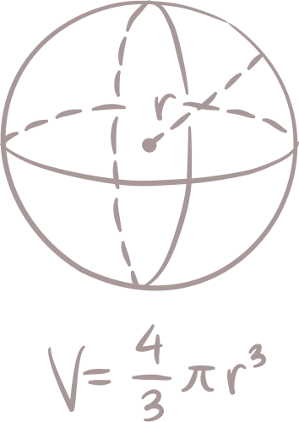
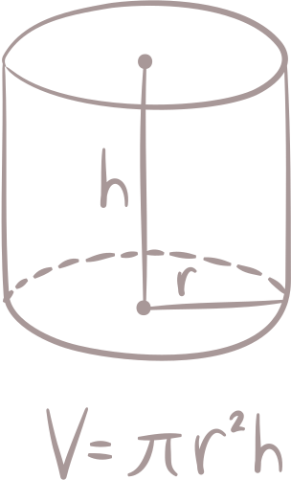
CSE-462
Integer
Linear
Programming
1905096 - Apurbo banik Turjo

Slide 2



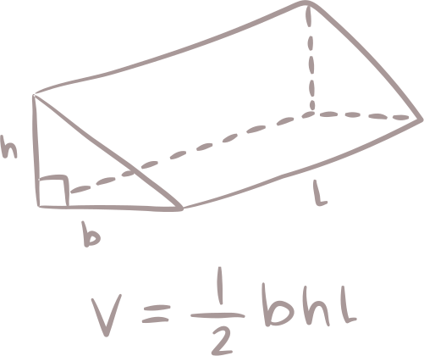
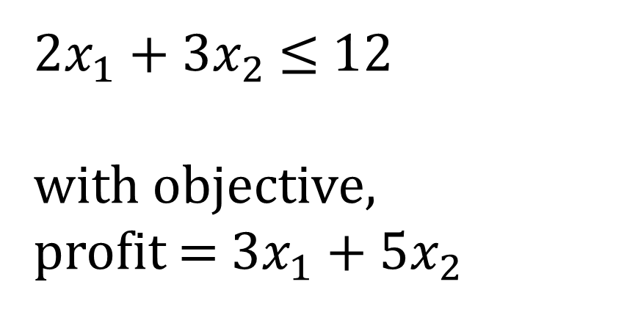
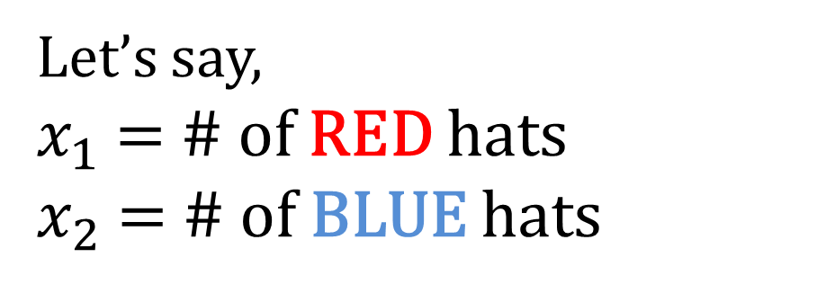
Q:
What’s this INTEGER LINEAR PROGRAMMING??
You want to sell hats and make as much as profit as possible
Mathematics to save the day!
3$
2hr to make
Let’s say,
$x_{1}$ = # of RED hats
$x_{2}$ = # of BLUE hats
5$
3hr to make
2$x_{1}$ + 3$x_{2}$ $≤$ 12
with objective,
profit = 3$x_{1}$ + 5$x_{2}$
You got 12 hours! – By Boss

Slide 3


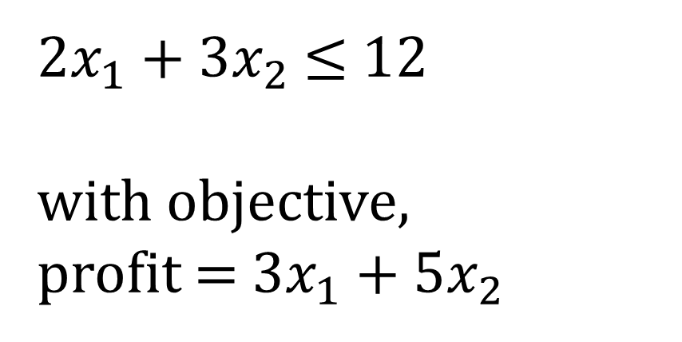
Q:
What’s this INTEGER LINEAR PROGRAMMING??
You want to sell hats and make as much as profit as possible
2$x_{1}$ + 3$x_{2}$ $≤$ 12
with objective,
profit = 3$x_{1}$ + 5$x_{2}$
3$
2hr to make
5$
3hr to make
Choices-
0 RED hats + 4 BLUE hats
profit = 20$
You got 12 hours! – By Boss
3 RED hats + 2 BLUE hats
profit = 19$

Slide 4

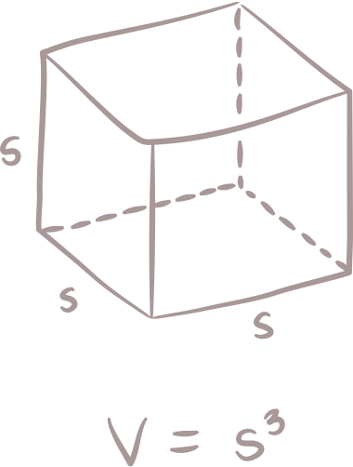


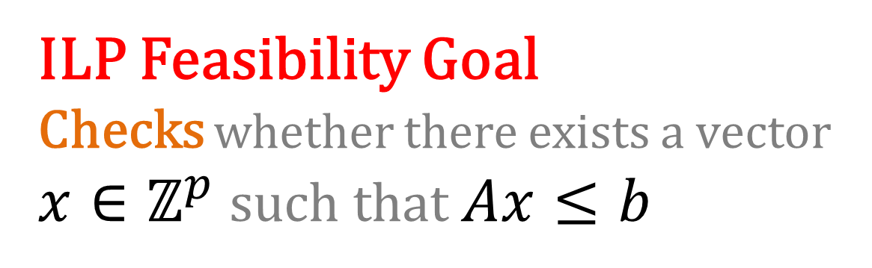


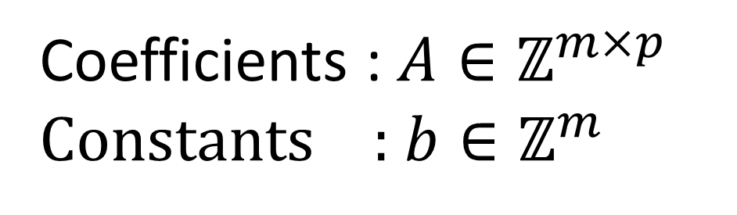
Formal:
Everything is integer
$$a_{1,1}x_{1}+a_{1,2}x_{2}+⋯+a_{1,p}x_{p}≤b_{1}$$
$$a_{2,1}x_{1}+a_{2,2}x_{2}+⋯+a_{2,p}x_{p}≤b_{2}$$
m constants
$$…$$
$$…$$
$$…$$
$$…$$
$$a_{m,1}x_{1}+a_{m,2}x_{2}+⋯+a_{m,p}x_{p}≤b_{m}$$
p variables / coefficients
Domain
ILP Feasibility Goal
Checks whether there exists a vector
$x∈ℤ^{p}$ such that $Ax≤b$
Coefficients : $A∈ℤ^{m×p}$
Constants : $b∈ℤ^{m}$
It’s known as FEASIBILITY check

Slide 5
Formal:
Everything is integer
$$a_{1,1}x_{1}+a_{1,2}x_{2}+⋯+a_{1,p}x_{p}≤b_{1}$$
$$a_{2,1}x_{1}+a_{2,2}x_{2}+⋯+a_{2,p}x_{p}≤b_{2}$$
m constants
$$…$$
$$…$$
$$…$$
$$…$$
$$a_{m,1}x_{1}+a_{m,2}x_{2}+⋯+a_{m,p}x_{p}≤b_{m}$$
p variables
ILP Feasibility Goal
Checks whether there exists an assignment of variables that satisfies all the inequalities

Slide 6
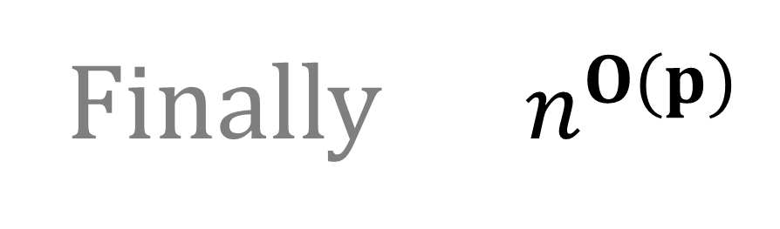
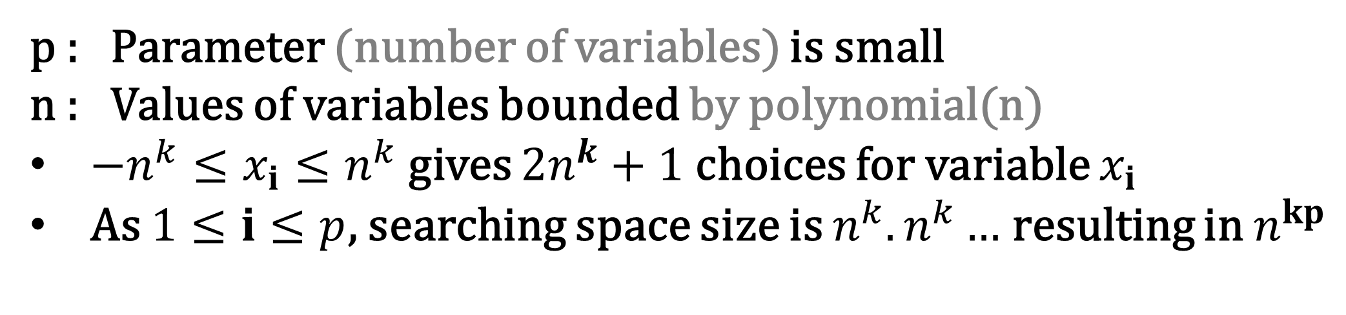
Complexity
ILP itself is NP-hard
So, we apply some constraints
p : Parameter (number of variables) is small
n : Values of variables bounded by polynomial(n)
$−n^{k}≤x_{i}≤n^{k}$ gives $2n^{k}+1$ choices for variable $x_{i}$
As $1≤ⅈ≤p$, searching space size is $n^{k}.n^{k}…$ resulting in $n^{kp}$
Finally $n^{O(p)}$

Slide 7

Theorem-1
ILP FEASIBILITY
Checking if an ILP problem’s solution exists
A better complexity
p : Parameter (number of variables) is small
n : Values of variables bounded by polynomial(n)
L : Problem instance size (f.e. # of coefficients, # of constants etc.)
Improved time complexity $O(p^{2.5+o\left(p\right)}.L)$
Slightly super-exponential dependence on the parameter
Grows slowly

Slide 8
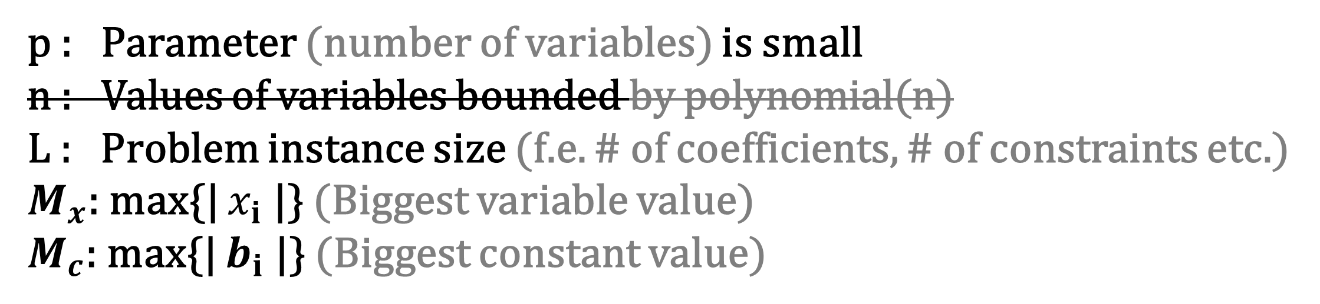
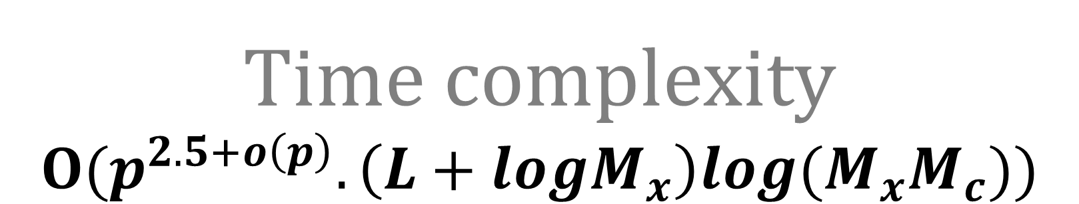
Theorem-2
ILP
Finding solution given a constraint
A better complexity
p : Parameter (number of variables) is small
n : Values of variables bounded by polynomial(n)
L : Problem instance size (f.e. # of coefficients, # of constraints etc.)
$M_{x}$: max{| $x_{i}$ |} (Biggest variable value)
$M_{c}$: max{| $b_{i}$ |} (Biggest constant value)
Time complexity $O(p^{2.5+o\left(p\right)}.\left(L+logM_{x}\right)log(M_{x}M_{c}))$
Bit Complexity

Slide 9


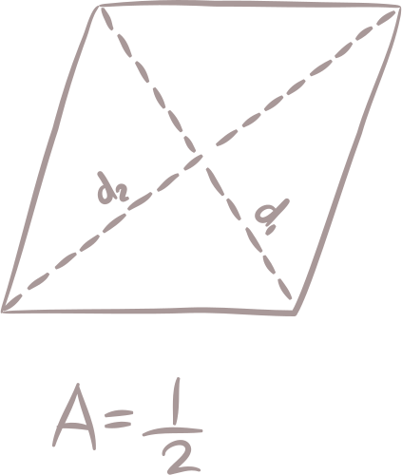
The imbalance problem
IMBALANCE
How "uneven" or "lopsided" the arrangement of vertices is in a graph.
Problem
The goal is to minimize the imbalance.
Friendship
Real World Example
Seating guests at a wedding
You want to seat people so that each person is close to their friends and the arrangement is balanced.

Slide 10
The imbalance problem
IMBALANCE
How "uneven" or "lopsided" the arrangement of vertices is in a graph.
Problem
The goal is to minimize the imbalance.
Friendship
Real World Example
Seating guests at a wedding
You want to seat people so that each person is close to their friends and the arrangement is balanced.

Slide 11
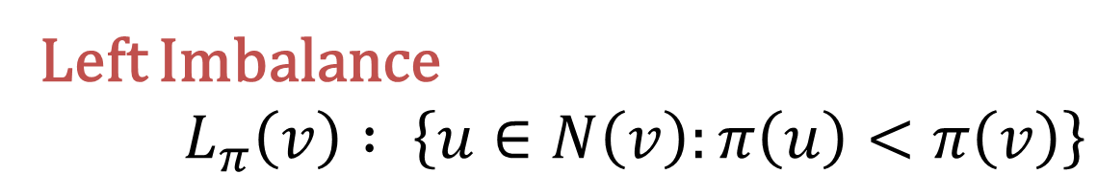

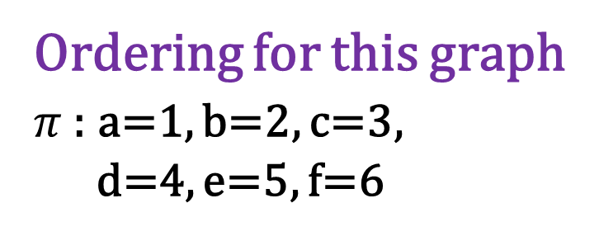

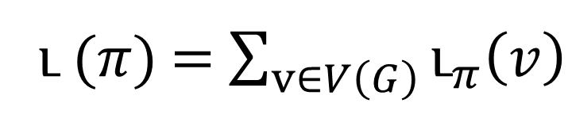

Example cont...
Vertex Ordering
$π :V\left(G\right)→\{1, 2, 3, …, n\}$
a
b
c
d
e
f
Ordering for this graph
$π$ : a=1, b=2, c=3,
d=4, e=5, f=6
Left Imbalance
$L_{π}\left(v\right) : \left\{u∈N\left(v\right):π\left(u\right)<π\left(v\right)\right\}$
Right Imbalance
$R_{π}\left(v\right) : \left\{u∈N\left(v\right):π\left(u\right)>π\left(v\right)\right\}$
${\text{ւ}}_{π}\left(v\right)$ $=\left\|L_{π}\left(v\right)| −|R_{π}\left(v\right)\right\|$
ւ ($π$) = $\sum_{v∈V\left(G\right)}{{\text{ւ}}_{π}\left(v\right)}$

Slide 12
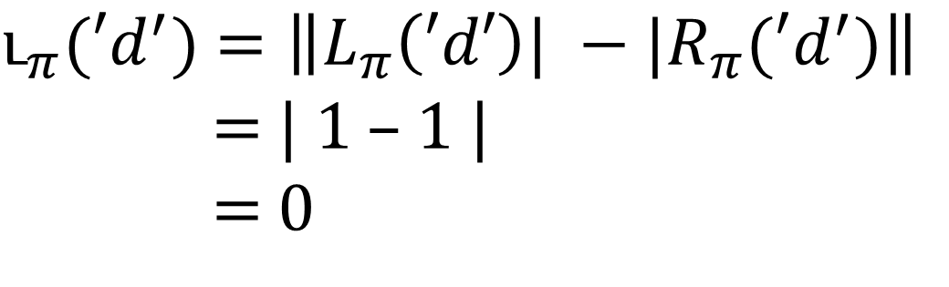
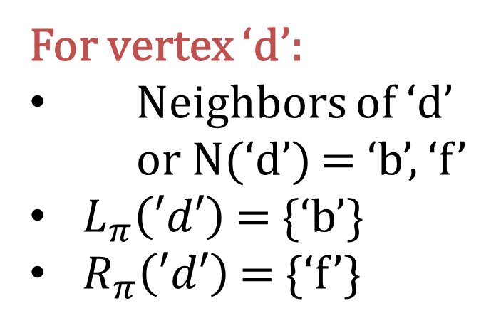
Imbalance (‘d’)
a
b
c
d
e
f
For vertex ‘d’:
Neighbors of ‘d’
or N(‘d’) = ‘b’, ‘f’
$L_{π}\left(′d′\right)$ = {‘b’}
$R_{π}\left(′d′\right)$ = {‘f’}
Ordering for this graph
$π$ : a=1, b=2, c=3,
d=4, e=5, f=6
${\text{ւ}}_{π}(′d^{′})$ $=\left\|L_{π}\left(′d′\right)| −|R_{π}(′d^{′})\right\|$
= | 1 – 1 |
= 0

Slide 13

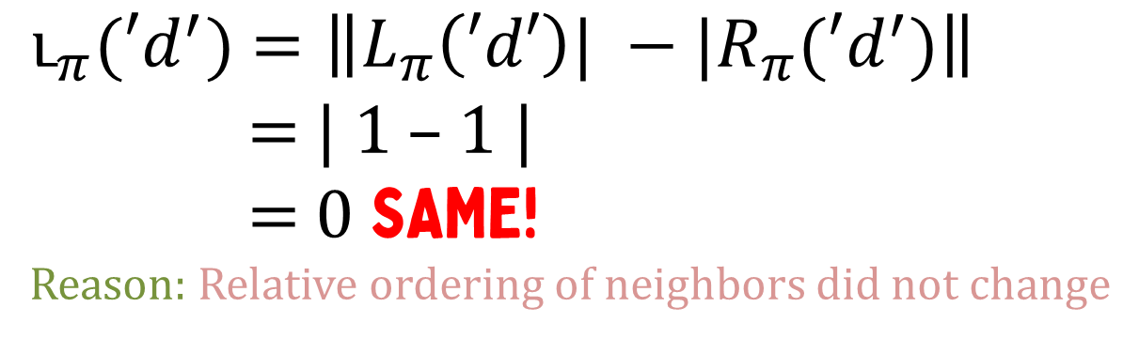
reordering
a
c
b
d
e
f
For vertex ‘d’:
Neighbors of ‘d’
or N(‘d’) = ‘b’, ‘f’
$L_{π}\left(′d′\right)$ = {‘b’}
$R_{π}\left(′d′\right)$ = {‘f’}
Ordering for this graph
$π$ : a=1, c=2, b=3,
d=4, e=5, f=6
${\text{ւ}}_{π}(′d^{′})$ $=\left\|L_{π}\left(′d′\right)| −|R_{π}(′d^{′})\right\|$
= | 1 – 1 |
= 0 SAME!
Reason: Relative ordering of neighbors did not change

Slide 14


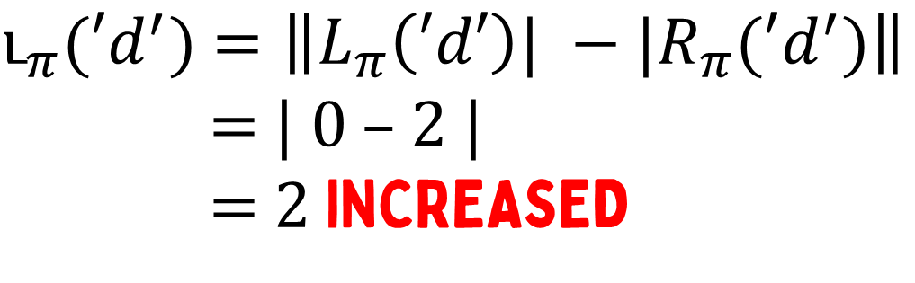
More reordering...
a
c
d
b
e
f
For vertex ‘d’:
Neighbors of ‘d’
or N(‘d’) = ‘b’, ‘f’
$L_{π}\left(′d′\right)$ = {}
$R_{π}\left(′d′\right)$ = {‘b’, ‘f’}
Ordering for this graph
$π$ : a=1, c=2, d=3,
b=4, e=5, f=6
${\text{ւ}}_{π}(′d^{′})$ $=\left\|L_{π}\left(′d′\right)| −|R_{π}(′d^{′})\right\|$
= | 0 – 2 |
= 2 INCREASED

Slide 15

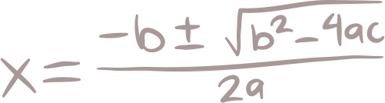
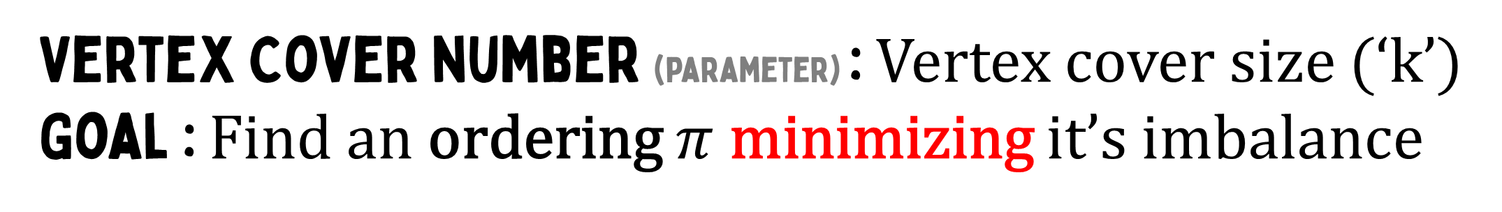
parameterization
Vertex Cover number (parameter) : Vertex cover size (‘k’)
Goal : Find an ordering $π$ minimizing it’s imbalance

Slide 16
parameterized imbalance problem
Input
Vertex cover of size ‘k’

Slide 17
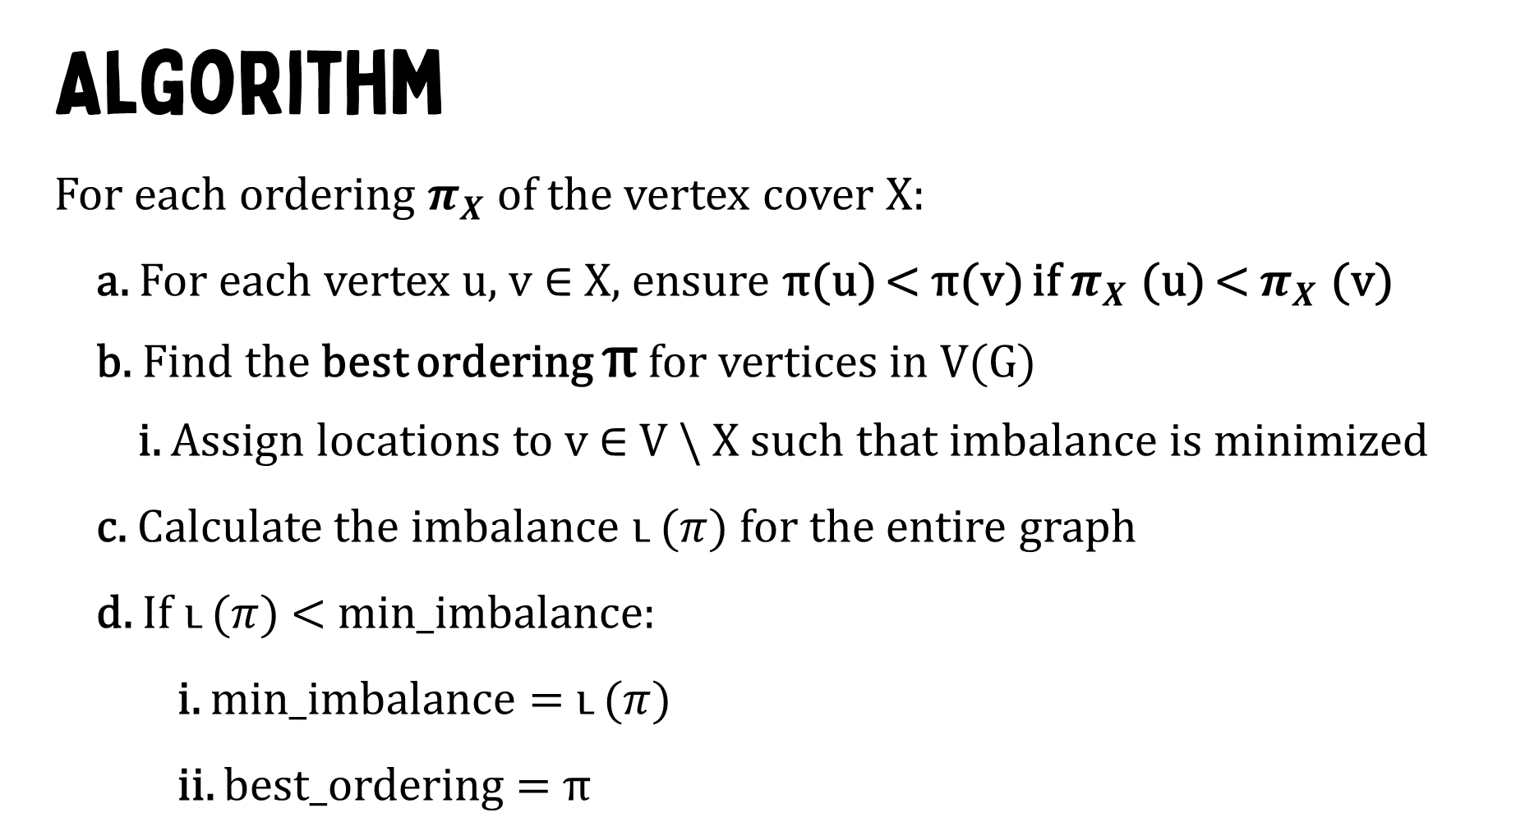
parameterized imbalance problem
Input
Vertex cover of size ‘k’
Algorithm
For each ordering $π_{X}$ of the vertex cover X:
a. For each vertex u, v ∈ X, ensure π(u) < π(v) if $π_{X}$ (u) < $π_{X}$ (v)
b. Find the best ordering π for vertices in V(G)
i. Assign locations to v ∈ V \ X such that imbalance is minimized
c. Calculate the imbalance ւ ($π$) for the entire graph
d. If ւ ($π$) < min_imbalance:
i. min_imbalance = ւ ($π$)
ii. best_ordering = π

Slide 18
methodology
a
b
c
d
e
f
Vertex Cover, X : {‘c’, ‘d’}
Independent Set, I : {‘a’, ‘b’, ‘e’, ‘f’}

Slide 19
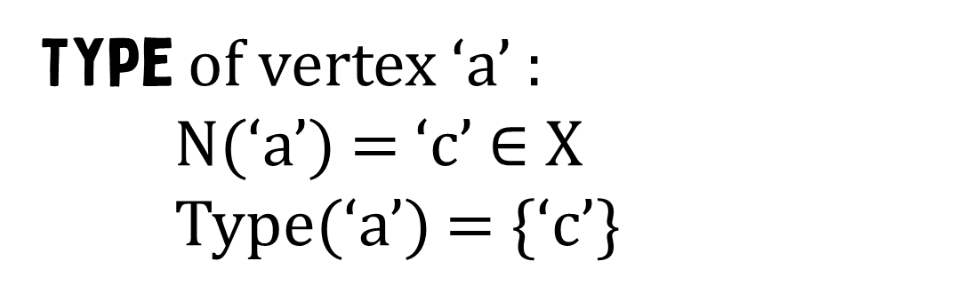
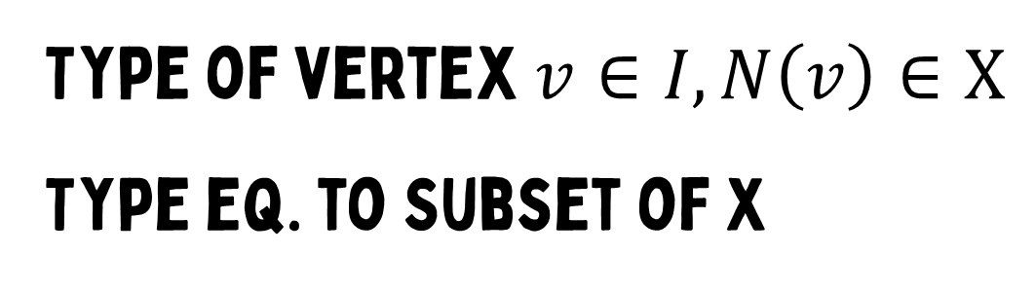
Vertex type !!
a
b
c
d
e
f
Vertex Cover, X : {‘c’, ‘d’}
Independent Set, I : {‘a’, ‘b’, ‘e’, ‘f’}
Type of vertex $v∈I,N\left(v\right)∈X$
Type eq. to Subset of X
Type of vertex ‘a’ :
N(‘a’) = ‘c’ $∈$ X
Type(‘a’) = {‘c’}

Slide 20
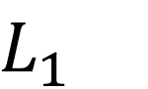

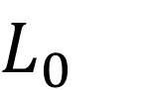
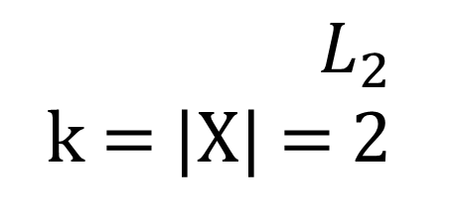
Vertex locations !!
a
b
c
d
e
f
Vertex Cover, X : {‘c’, ‘d’}
Independent Set, I : {‘a’, ‘b’, ‘e’, ‘f’}
location of vertex $v∈I$
Possible locations of vertex ‘a’ :
{‘a’, ‘c’, ‘d’}
{‘c’, ‘a’, ‘d’}
{‘c’, ‘d’, ‘a’}
$$L_{0}$$
$$L_{1}$$
$L_{2}$
k = |X| = 2

Slide 21

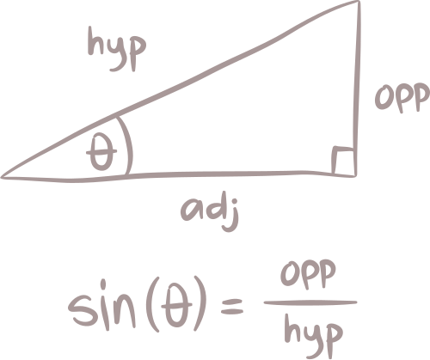
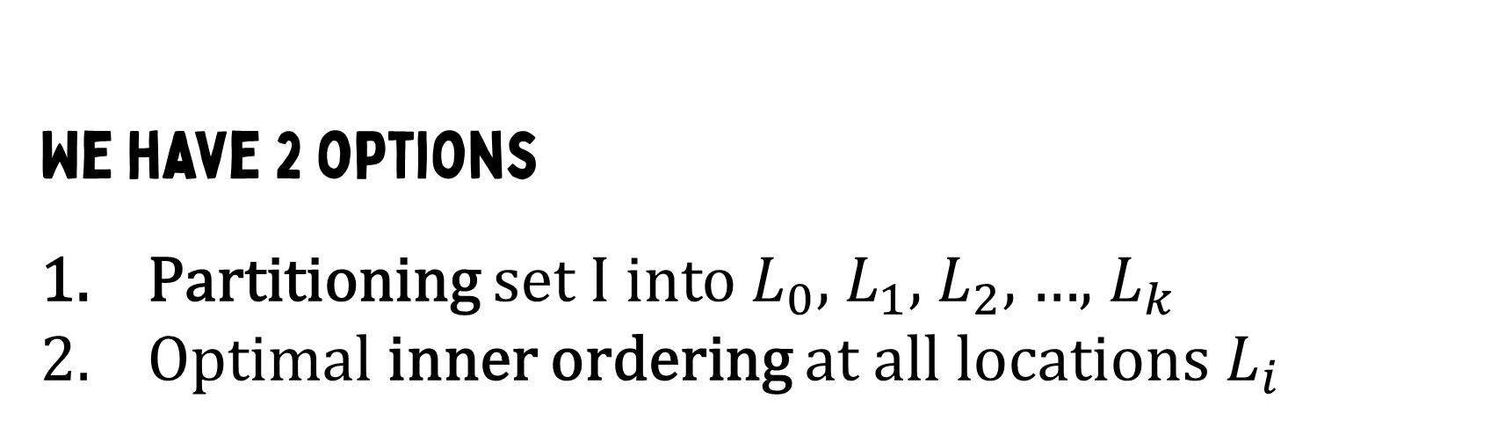
Connection with iLP
We have 2 options
Partitioning set I into $L_{0}$, $L_{1}$, $L_{2}$, …, $L_{k}$
Optimal inner ordering at all locations $L_{i}$

Slide 22

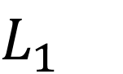
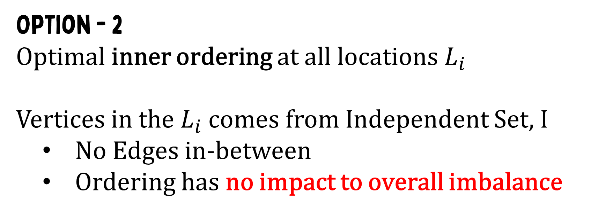
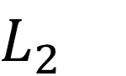
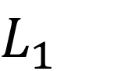
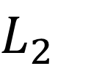
Connection with iLP
Option - 2
Optimal inner ordering at all locations $L_{i}$
Vertices in the $L_{i}$ comes from Independent Set, I
No Edges in-between
Ordering has no impact to overall imbalance
{‘c’, ‘a’, ‘b’, ‘d’, ‘e’}
{‘c’, ‘b’, ‘a’, ‘d’, ‘e’}
$$L_{1}$$
$$L_{2}$$
$$L_{1}$$
$$L_{2}$$

Slide 23

Connection with iLP
Boils down to Option – 1
Partitioning set I and finding $L_{i}$ set elements
Sounds like ilp !
Finding assignments to variables

Slide 24
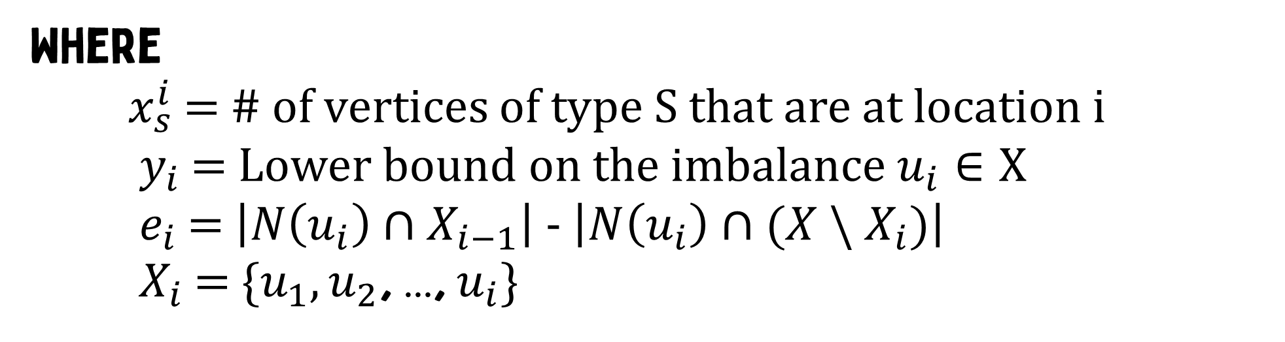
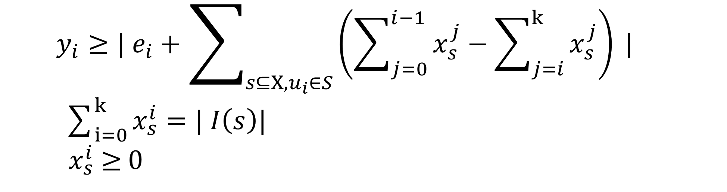
The final touch
All we need now are the inequalities
$y_{i}≥| e_{i}+\sum_{s⊆X,u_{i}∈S}{\left(\sum_{j=0}^{i−1}{x_{s}^{j}}−\sum_{j=i}^{k}{x_{s}^{j}}\right) |}$
$\sum_{i=0}^{k}{x_{s}^{i}}=| I\left(s\right)|$
$x_{s}^{i}$ $≥$ 0
Where
$x_{s}^{i}$ = # of vertices of type S that are at location i
$y_{i}$ = Lower bound on the imbalance $u_{i}∈X$
$e_{i}$ = $\left|N\left(u_{i}\right)∩X_{i−1}\right|$ - $\left|N\left(u_{i}\right)∩{(X \backslash X}_{i})\right|$
$X_{i}$ = {$u_{1},u_{2}$, …, $u_{i}\}$

Slide 25

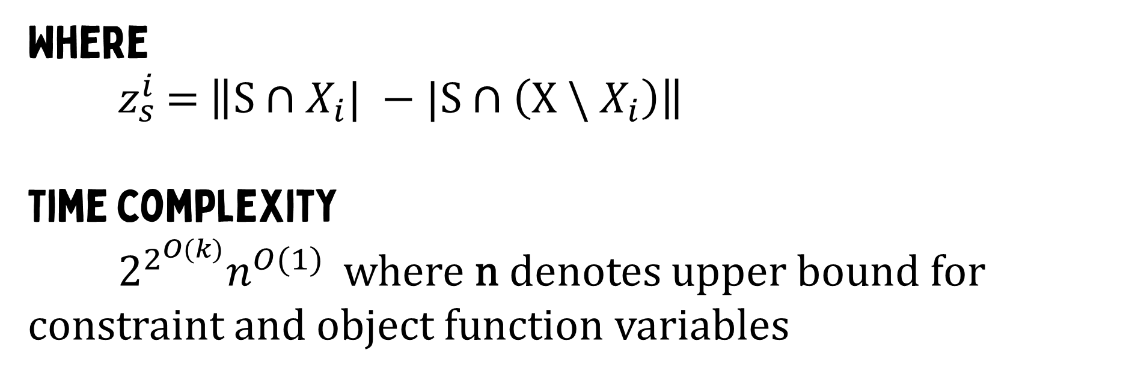
The final touch
Objective function
$min\sum_{i=1}^{k}{y_{i}}+ Σ_{i=0}^{k}Σ_{S⊆X}z_{S}^{i}x_{S}^{i}$
Where
$z_{s}^{i}$ = $\left\|S∩X_{i}| −|S∩\left(X \backslash X_{i}\right)\right\|$
Time complexity
$2^{2^{O(k)}}n^{O(1)}$ where n denotes upper bound for constraint and object function variables

Slide 26




Any Questions?

